Slide 1
- Scheme for Subsidy on Exchange for Post-secondary Students (SSE) - Scheme for Means-tested Subsidy on Exchange to “Belt and Road” Regions for Post-secondary Students (Means-tested SSEBR) Nov 2022

Slide 2
Schemes for Subsidy on Exchange

Slide 3
Scheme for Subsidy on Exchange
Background
To provide local students of full-time locally-accredited programmes at undergraduate levels (including top-up) with means-tested grant to participate in exchange activities outside Hong Kong
To ensure that no post-secondary students will be denied access to exchange activities due to a lack of financial means
SSEBR is specially established to strengthen and promote further educational exchanges between Hong Kong and the nearby countries along the Belt and Road (B&R) regions
Notes:
Background Information: for full-time UGC-funded students
必須被獲選參加IO／GCA organized SEP
目的：幫助有經濟困難嘅同學參加 Exchange
同學必須通過家庭入息審查，入息審查會按照一般批HKIEd General Bursary啲做法去做，同學唔係一申請就有

Slide 4
Scheme for Subsidy on Exchange
Eligible Exchange Activities
SSE | Means-tested SSEBR
Outbound activity comprising substantive teaching and learning elements | Outbound activity comprising substantive teaching and learning elements to be held in any “Belt and Road” countries, excluding the Mainland/Taiwan/Macao
Organized and/or endorsed by EdUHK
If the exchange activity is not organized by EdUHK, the hosting institution must be a recognized educational institution/body either in Hong Kong or in the home country
Programme duration: at least 14 days | Programme duration: at least 5 days
Other things being equal, priority to be given to credit-bearing or award-bearing exchange activities.
Notes:
Various Bursary amount: ranging from 2,500 to 10,000 depends on exchange region
助學金金金額可能會按各 exchange region 之洗費調整

Slide 5
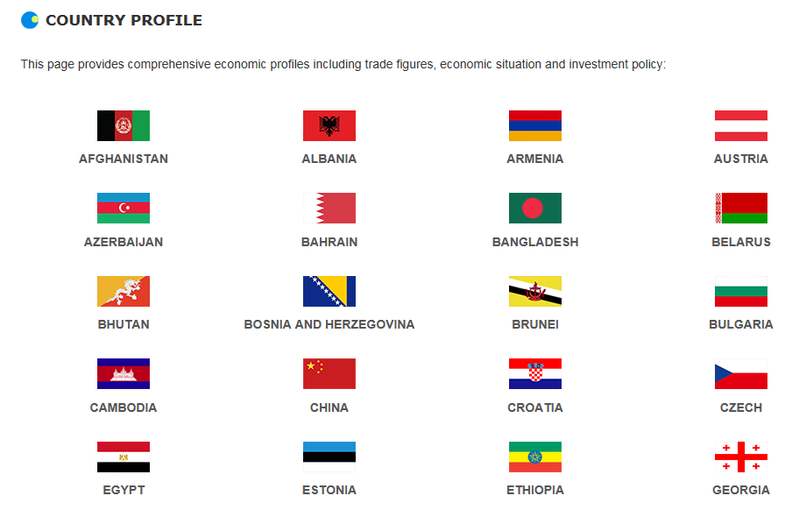
Scheme for Subsidy on Exchange
“Belt and Road” country/economy listed at Hong Kong Trade Development Council
*Subject to review and update from time to time
Notes:
獲發助學金同學需要交 Bursary Undertaking
同學必須完成該 Exchange 同埋在exchange 期間保持滿意表現

Slide 6
Scheme for Subsidy on Exchange
Level of Subsidy - SSE
(A)
(B)
Destination | Subsidy Amount ($)
Asia (including Middle East) | 3,000
Africa | 7,000
Oceania & Europe | 8,000
North America | 9,000
Central & South America & Caribbean | 15,000
Duration (Days) | Subsidy Amount ($)
14-28 | 6,000
29-90 | 10,000
91-180 | 25,000
Over 180 | 45,000
Means-tested SSEBR
(A)
(B)
Destination | Subsidy Amount ($)
Asia (including Middle East, excluding the Mainland/Tawian/Macao) | 3,000
Africa | 7,000
Oceania & Europe | 8,000
Central & South America & Caribbean | 15,000
Duration (Days) | Subsidy Amount ($)
5-13 | 3,500
14-28 | 6,000
29-90 | 10,000
91-180 | 25,000
Over 180 | 45,000
Notes:
Various Bursary amount: ranging from 2,500 to 10,000 depends on exchange region
助學金金金額可能會按各 exchange region 之洗費調整

Slide 7
Scheme for Subsidy on Exchange
Calculation Formula
Maximum subsidy amount granted
[Component (A) + Component (B)] x level of student finance approved by SFO
(in terms of % of full grant)
Example
If a student is receiving 50% of full grant from Student Finance Office (SFO) joins an exchange activity in Hungary for 100 days, the maximum amount of the subsidy will be HK$16,500. In cases where the financial assistance level by the SFO is lower than 50%, the financial assistance level to be adopted in the calculation will be adjusted upward to 50%.
Calculation:
Max. Subsidy Amount Granted
= 50% x [(a)$8,000 + (b)$25,000]= HK$16,500
Notes:
Various Bursary amount: ranging from 2,500 to 10,000 depends on exchange region
助學金金金額可能會按各 exchange region 之洗費調整

Slide 8
Scheme for Subsidy on Exchange
Eligibility Criteria
Target Student | Local students enrolled in full-time locally-accredited undergraduate programmes at the time of application and throughout the duration of subsidized exchange activity
General Requirements | Being selected to participate in and able to complete outbound exchange programme; Recipient of means-tested financial assistance (i.e. approved grant under TSFS or FASP) from Student Finance Office (SFO) OR whose families are in receipt of the Comprehensive Social Security Assistance (CSSA) by the time student applies or is nominated for an outbound exchange programme; For SSE applicants: Have not received any subsidy under the SSE before at the current level of study For Means-tested SSEBR applicants: Have received not more than once subsidy under the SSEBR at the current level of study Selected through a merit-based mechanism administered by EdUHK
Notes:
讀 full-time UGC-funded programme LOCAL students
必須被獲選參加IO／GCA organized SEP
同學必須通過家庭入息審查，入息審查會按照一般批HKIEd General Bursary啲做法去做，同學唔係一申請就有
同學如獲發助學金，而獲發助學金之後，個shortfall of estimated cost 不能多於該地區的exchange bursary
以下有兩個example 說明

Slide 9
Scheme for Subsidy on Exchange
Selection Criteria
Students are only eligible for the SSE once throughout their study in programmes at the same level of study
Students are eligible for SSEBR twice at most, subject to the maximum amount of subsidy of HK$60,000 discounted by the latest level of student finance throughout their study at the same level
Destinations of every exchange activities subsidized under SSEBR and SSE should be different in terms of country/economy
Priority should be given to credit-bearing or award-bearing exchange programme
Subject to subsidy funding available
Notes:
同學必須通過家庭入息審查，入息審查，機制參考政府學生資助辨事處－資助專上課程學生資助計劃
同學如果有申請Grant Loan 而有 Grant Loan Result, 請準備定；因為將會有政府交流助學金，而該助學金有需要 Grant Loan Result,詳情會在稍後助學金申請時公佈
除咗付合家庭入息審查之外，都要視乎院校該年院校之Bursary Funding

Slide 10
Scheme for Subsidy on Exchange
Major Features | SSE | Means-tested SSEBR
Eligible Exchange Programme/ Activity | Outbound activity comprising substantive teaching and learning elements 2. Programme duration: at least 2 weeks | Outbound activity comprising substantive teaching and learning elements to be held in any “Belt and Road” country/economy, excluding the Mainland/Taiwan/Macao. 2. Programme duration: at least 5 days
Subsidy Amount | Destination Subsidy Amount($) Asia (including Middle East) 3,000 Africa 7,000 Oceania & Europe 8,000 North America 9,000 Central &South America 15,000 & Caribbean Duration (Days) Subsidy Amount ($) 14-28 6,000 29-90 10,000 91-180 25,000 Over 180 45,000 | Destination Subsidy Amount($) Asia (including Middle East, 3,000 excluding Mainland/Taiwan/Macao) Africa 7,000 Oceania & Europe 8,000 Central & South America & 15,000 Caribbean Duration (Days) Subsidy Amount ($) 5-13 3,500 14-28 6,000 29-90 10,000 91-180 25,000 Over 180 45,000
Eligibility | Students are only eligible for assistance under the scheme once throughout their study in programmes at the same level of study | Students are only eligible for assistance under the scheme twice at most, subjected to max. amount of subsidy to be received by him/her under Means-tested SSEBR
Notes:
獲發助學金同學需要交 Bursary Undertaking
同學必須完成該 Exchange 同埋在exchange 期間保持滿意表現

Slide 11
Scheme for Subsidy on Exchange
Supporting Documents Needed
SID copy
2. Grant/Loan Notification Result or Notification Letter on Comprehensive Social Security Assistance (if any)
3. Acceptance Letter issued from the overseas exchange institution
*Incomplete or late applications will not be processed
Notes:
同學必須通過家庭入息審查，入息審查，機制參考政府學生資助辨事處－資助專上課程學生資助計劃
同學如果有申請Grant Loan 而有 Grant Loan Result, 請準備定；因為將會有政府交流助學金，而該助學金有需要 Grant Loan Result,詳情會在稍後助學金申請時公佈
除咗付合家庭入息審查之外，都要視乎院校該年院校之Bursary Funding

Slide 12
Scheme for Subsidy on Exchange
Approved means-tested grant
Student Name
Student ID & HKID
TSFS / FASP
Amount > 0
Notes:
合資格同學會在2月中收到email invitation;詳述各助學金申請資格；同學必須閱讀清楚整份 Application Guideline
在Application deadline 前遞交所有 supporting 同 application form 去 SAO

Slide 13
Non-means-tested Schemes for Subsidy on Exchange
Non-means-tested Mainland Experience Subsidy (Non-means-tested MES)
Non-means-tested SSEBR

Slide 14
Non-means-tested Schemes for Subsidy on Exchange
Eligible Exchange Activities
Non-means-tested MES |  | Non-means-tested SSEBR
Outbound activity comprising substantive teaching and learning elements to be held in the Mainland |  | Outbound activity comprising substantive teaching and learning elements to be held in any “Belt and Road” countries, excluding the Mainland/Taiwan/Macao
Organised and/or endorsed by EdUHK
If the exchange activity is not organized by EdUHK, the hosting institution must be a recognized educational institution/body either in Hong Kong or in the home country
Programme duration: at least 3 days | Programme duration: at least 5 days
Other things being equal, priority to be given to credit-bearing or award-bearing exchange activities.
Notes:
Various Bursary amount: ranging from 2,500 to 10,000 depends on exchange region
助學金金金額可能會按各 exchange region 之洗費調整

Slide 15
Non-means-tested Schemes for Subsidy on Exchange
Major Features | Non-means-tested MES | Non-means-tested SSEBR
Eligible Exchange Programme/ Activity | Outbound activity comprising substantive teaching and learning elements to be held in the Mainland 2. Programme duration: at least 3 days | Outbound activity comprising substantive teaching and learning elements to be held in any “Belt and Road” country/economy, excluding the Mainland/Taiwan/Macao. 2. Programme duration: at least 5 days
Subsidy Amount | Destination Subsidy Amount($) The Mainland 900 Duration (Days) Subsidy Amount ($) 5-13 1,050 14-28 1,800 29-90 3,000 91-180 7,500 Over 180 13,500 | Destination Subsidy Amount($) Asia (including Middle East, 900 excluding Mainland/Taiwan/Macao) Africa 2,100 Oceania & Europe 2,400 Central & South America & 4,500 Caribbean Duration (Days) Subsidy Amount ($) 5-13 1,050 14-28 1,800 29-90 3,000 91-180 7,500 Over 180 13,500
Eligibility | Local and Non-local students are only eligible for assistance under the scheme once throughout their study in programmes at the same level of study | Local students are only eligible for assistance under the scheme once throughout their study in the programmes at the same level of study.
Notes:
獲發助學金同學需要交 Bursary Undertaking
同學必須完成該 Exchange 同埋在exchange 期間保持滿意表現

Slide 16
Non-means-tested Scheme for Subsidy on Exchange
Supporting Documents Needed
SID copy
2. Acceptance Letter issued from the overseas exchange institution
*Incomplete or late applications will not be processed
Notes:
同學必須通過家庭入息審查，入息審查，機制參考政府學生資助辨事處－資助專上課程學生資助計劃
同學如果有申請Grant Loan 而有 Grant Loan Result, 請準備定；因為將會有政府交流助學金，而該助學金有需要 Grant Loan Result,詳情會在稍後助學金申請時公佈
除咗付合家庭入息審查之外，都要視乎院校該年院校之Bursary Funding

Slide 17
For both means-tested and non-means-tested Scheme for Subsidy on Exchange
Subsidy Recipient’s Obligations
Sign an online undertaking form to comply with respective terms and conditions; and
Submit Declaration for Exchange Subsidy Claim Form together with three major receipt copies WITHIN one month after the programme end date.
EdUHK reserves the right to demand return of any subsidy amount granted if the subsidy recipients do not fulfill any of the above conditions or subsidy received is greater than actual direct costs associated with the exchange activity
Notes:
獲發助學金同學需要交 Bursary Undertaking
同學必須完成該 Exchange 同埋在exchange 期間保持滿意表現

Slide 18
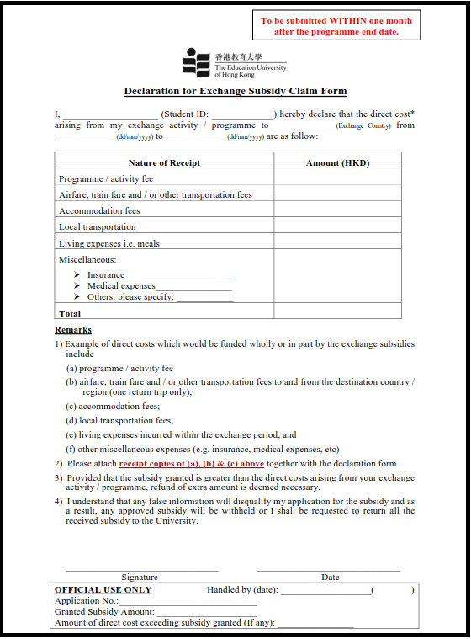
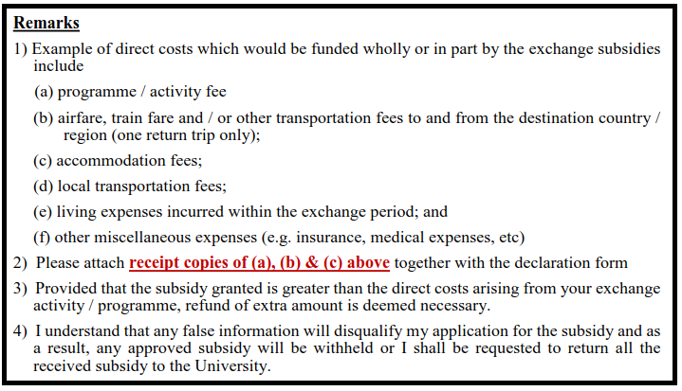
For both means-tested and non-means-tested Scheme for Subsidy on Exchange
Declaration for Exchange Subsidy Claim Form
Notes:
合資格同學會在2月中收到email invitation;詳述各助學金申請資格；同學必須閱讀清楚整份 Application Guideline
在Application deadline 前遞交所有 supporting 同 application form 去 SAO

Slide 19
Workflow

Slide 20
Scheme for Subsidy on Exchange
Application Flowchart
* The approved subsidy will be issued in two installments: 70% will be issued before the exchange activity while the remaining 30% will be issued after submission of Declaration for Exchange Subsidy Claim Form.
* Student should launch application within one month after the programme end date, the latest, while the exchange activity in a certain academic year should be completed on or before 31 August of that academic year only.
Notes:
獲發助學金同學需要交 Bursary Undertaking
同學必須完成該 Exchange 同埋在exchange 期間保持滿意表現

Slide 21
Scheme for Subsidy on Exchange
Enquiries
Student Affairs Office
Ms. Sally Ng
Email: saosfa@eduhk.hk
Webpage: https://www.eduhk.hk/sao/info/student_finance/schemes_for_subsidy_on_exchange/
Location: Cho Kwai Chee Foundation Building, 1/F-01
Office Hour: [Mon-Fri] 8:30 am – 5:20 pm

