Slide 1
Briefing Sessions on Financial Assistance
Billy Lam
Student Affairs Office

Slide 2
Outline
Introduction to Financial Assistance
Institutional Fees Matters
Financial Assistance Schemes

Slide 3
Introduction to Financial Assistance

Slide 4
Major Expenditures
Tuition Fee
Hall Fee
Academic Expenses (reference books, exam fees, immersion fee, etc.)
Expenses on Co-curricular Activities (internship, training, community service, study tour, etc.)
Living Expenses (transportation, meals, etc.)

Slide 5
Sources of Funding
Government
EdUHK
Non-governmental / Professional Organizations
Donations to EdUHK

Slide 6
Institutional Fees Matters

Slide 7
Institutional Fees Matters
e-Billing
No hard copy of Institutional Fees Billing
e-Billing Notice through student email account
View the Consolidated e-Billing by clicking the following link:
http://portal.eduhk.hk , and then Login
The Portal → e-SIS → e-SIS → Student Services → Student Account
→ Account Summary (Consolidated e-Billing)
Institutional Fees Payment due dates for 2023/24
Undergraduate/HD(ECE) Programmes
Semester 1 (Oct 2023)
Semester 2 (Feb 2024)

Slide 8
Institutional Fees Matters
Payment Methods
[Bill Payment]
Automatic Teller Machine (“ATM”)/ JETCO ATM
PPS
Internet Banking Services (credit cards/ savings accounts)
Cross-border Bill payment (for ICBC China account only)
[Bank Deposit]
Make deposit at any of the Bank of East Asia branches (A/C no. 015-195-40-00511-5)
https://www.eduhk.hk/include_n/getrichfile.php?key=8804318740e26d13970ab32665f6d28b&secid=2431&filename=fo/Payment_Methods.pdf

Slide 9
Institutional Fees Matters
**Please choose/enter Bill Type “01”-“03” and the 8-digit student number as the Bill Number for payment by all methods
**Please settle different Bill Type charges by choosing/entering the corresponding Bill Type number in your settlement.
Bill Type 01: Tuition & its related fees
Bill Type 02: Hostel & its related fees
Bill Type 03: Miscellaneous fees

Slide 10
Institutional Fees Matters
For example:
Student A (SID 11100011) has 3 type of charges in 2023/24 Semester 1
Bill Type 01: Tuition $21,050
Bill Type 02: Hostel $4,900
Bill Type 03: Miscellaneous $350
Step for settlement by ATM will be (by 3 transactions):
→Bill payment→ Education-Universities→ EDUHK→01→11100011→ $21,050
→Bill payment→ Education-Universities→ EDUHK→02→11100011→ $4,900
→Bill payment→ Education-Universities→ EDUHK→03→11100011→ $350

Slide 11
Institutional Fees Matters
IMPORTANT
CASH payment of Institutional Fees is NOT accepted at ANY offices/hostels in the University
Please DO NOT use Faster Payment System (FPS轉數快 – a kind of fund Transfer, not Bill Payment) to settle the Institutional Fees when using Internet Banking Service.

Slide 12
Institutional Fees Matters
Receipt
Tuition Receipts – download/print Online Tuition Receipt in The Portal
No receipt can be generated with unsettled fees
Payment deferment – Automatically
Applicable to Full-time students** in Sub-degree/ Undergraduate Programmes/ University Grants Committee (“UGC”)-funded or Self-finance Programmes; AND
Have applied for financial assistance from the Student Finance Office (“SFO”)
**No payment deferment for all part-time students

Slide 13
Institutional Fees Matters
Payment deferment – Applied by students
Contact the Finance Office (“FO”) by sending email to fees@eduhk.hk in advance to explain why unable to pay the Institutional Fees by the due dates and propose a revised payment schedule.
Will ONLY consider cases with the following situation:
Students with sudden and genuine financial hardship and can provide supporting evidences.

Slide 14
Institutional Fees Matters
Unofficially Withdrawn (“UW”)
Failure to pay Institutional Fees by due dates will be treated as UNOFFICIALLY WITHDRAWN (“UW”) from the programme of studies
Suspension of access to the University’s facilities, withholding issuance of academic documents, etc.
Require to pay an Administration Fee of HK$300 for re-activating student status in addition to full settlement of overdue fees
Require to re-apply for admission again for prolonged outstanding debts even the settlement of previous debts with the University is made thereafter.
Not allowed to go for Overseas Student Activities even contribution is made. (e.g. Immersion Prog, cultural exchange projects and study tours, etc.)

Slide 15
Institutional Fees Matters
Overpayment in student account
Overpayment and/or NLS loan after settling the Institutional Fees will be refunded to students by the FO
Summary
Student’s responsibility﹕ Check student’s account balance and due dates in The Portal from time to time and pay all fees on time

Slide 16
Financial Assistance Scheme

Slide 17
Financial Assistance Scheme (UGC-funded Programmes)
Government Financial Assistance
Tertiary Student Finance Scheme - Publicly-funded Programmes (TSFS)
資助專上課程學生資助計劃
Non-means-tested Loan Scheme for Full-time Tertiary Students (NLSFT)
全日制大專學生免入息審查貸款計劃

Slide 18
Financial Assistance Scheme
Engaged in one full-time UGC-funded programme
Have the right of abode in the HKSAR or have resided or have had your home in Hong Kong continuously for 3 complete years prior to the commencement of the course
Not including students holding student visas
No age limit

Slide 19
Financial Assistance Scheme (Self-funded Programmes)
Government Financial Assistance
Financial Assistance Scheme for Post-secondary Students (FASP)
專上學生資助計劃
Non-means-tested Loan Scheme for Post-secondary Students (NLSPS)
專上學生免入息審查貸款計劃

Slide 20
Financial Assistance Scheme
Engaged in one full-time Self-funded programme
Have the right of abode in the HKSAR or have resided or have had your home in Hong Kong continuously for 3 complete years prior to the commencement of the course
Not including students holding student visas
Age Limit:
FASP, Aged 30 or below
NLSPS, No limit

Slide 21
TSFS (Grant & Loan)
TSFS (資助專上課程學生資助計劃)
Grant (助學金) + Loan (貸款)
Grant (助學金) – no need to repay
Tuition Fee (學費) (max)
- Postgraduate Programme: $42,100
- Bachelor Programme: $42,100
- Higher Diploma Programme: $15,040
Academic Expenses (開習支出) (max)
- Arts: $12,680 - Social Science: $10,470
- Education: $8,470 - Fine Arts/Design: $41,490
- Science: $9,140 - Music: $31,120

Slide 22
TSFS (Grant & Loan)
Additional Subsidies
Grant for overseas compulsory field trips
6-8 week ENG Max $7560, 8-10 week ENG Max $9180
6-8 week PTH Max $3600, 8-10 week PTH Max $4140
Hostel Subsidy
Confirmed to have resided in student hostels for at least 75% of the time during the semester(s)
Hostel fee or $10,190 per year/ $5,095 per semester, whichever is lower.
Academic expenses grant for students with SEN students
An additional academic expenses grant of up to $9,630 every year.
Student Travel Subsidy
reside beyond 10 minutes' walking distance from student's normal place of study and travel to school by public transport
not applicable to postgraduate students or hall residents
No need to submit separate applications. (Except AE Grant for SEN)
Subject to the student’s level of assistance assessed under TSFS.

Slide 23
FASP (Grant & Loan)
FASP (專上學生資助計劃)
Grant (助學金) + Loan (貸款)
Grant (助學金) – no need to repay
Tuition Fee (學費) (max)
$91,040
Academic Expenses (開習支出) (max)
$8,810

Slide 24
FASP (Grant & Loan)
Additional Subsidies
Hostel Subsidy
Confirmed to have resided in student hostels for at least 75% of the time during the semester(s)
Hostel fee or $10,190 per year/ $5,095 per semester, whichever is lower.
Academic expenses grant for students with SEN students
An additional academic expenses grant of up to $9,630 every year.
Student Travel Subsidy
reside beyond 10 minutes' walking distance from student's normal place of study and travel to school by public transport
not applicable to postgraduate students or hall residents
No need to submit separate applications. (Except AE grant for SEN Students)
Subject to the student’s level of assistance assessed under FASP.

Slide 25
TSFS/FASP (Grant & Loan)
Calculation of Financial Assistance
Step 1 - Income Assessment (1/4/2022 – 31/3/2023)
Incomes of parents / spouse
+ Income of unmarried siblings living together × 30%
+ Full-time income/studentship of the applicant
- Deductible medical expenses (2023/24 max.: $22,790)
= Total Family Income
÷ (number of family members + 1)*__________________
= Adjusted Family Income (AFI)
(調整後家庭收入)
-> Determine the preliminary level of Grant & Loan
* ( for single-parent families of 2 to 3 members : + 2 )

Slide 26
TSFS/FASP (Grant & Loan)
Calculation of Financial Assistance
First-tier: Adjusted Family Income (AFI)
AFI thresholds for full level of assistance for 3-member and 4-member families are $50,323 and $46,297 respectively. For 2-member single-parent families and 3-member single-parent families, they are regarded as 3-member families and 4-member families respectively for determining the AFI thresholds for full level of assistance and calculation of AFI.
3 人家庭和 4 人家庭可獲全額資助的「調整後家庭收入」上限分別為 51,523 元和 47,402 元。就 2 人和 3 人單親家庭而言，有關家庭會分別視為 3 人和 4 人家庭，以決定可獲全額資助的「調整後家庭收入」上限及計算「調整後家庭收入」。
AFI Groups (HK$) | % of Maximum Grant | % of Maximum Loan
0 to 43,495 | 100%* | 100%*
43,496 to 53,280 | 75% | 75%
53,281 to 62,890 | 50% | 50%
62,891 to 72,521 | 25% | 25%
72,522 to 84,105 | 15% | 15%
> 84,105 | 0% | 0%

Slide 27
TSFS/FASP (Grant & Loan)
Calculation of Financial Assistance
Step 2 - Asset Assessment (1/4/2022 – 31/3/2023)
Total asset amount of parents / spouse
+ Total asset amount of the applicant_______
= Total Family Asset Amount
÷ Number of family members_____________
= Net Asset Value Per Family Member
-> Determine the final level of Grant & Loan

Slide 28
TSFS/FASP (Grant & Loan)
Calculation of Financial Assistance
Second-tier: Discounting factor of Asset Value
Net Asset Value per Family Member (HK$) | Discount Factor of Grant/Loan Assistance
Over 820,000 | -100% (i.e. no assistance)
689,001 to 820,000 | -80%
553,001 to 689,000 | -60%
440,001 to 553,000 | -40%
292,001 to 440,000 | -20%
292,000 or below | -0% (i.e. no reduction of assistance)

Slide 29
TSFS/FASP (Grant & Loan)
Family Income
Salary薪金, wage工資, bonus花紅, allowance津貼, commission佣金, part-time income兼職收入, lump sum gratuity一次過的退休金, monthly pension每月退休金, studentship研究生助學金
Business profit營業盈利, remittance匯款, contribution補助款(家用及生活費), alimony贍養費, contribution for mortgage repayment/ rental received家庭成員繳交的樓宇供款、租金開支、保險費及還款等
Rental income of property/ land/ carpark/ vehicle/vessel物業、土地、車位、車輛、船隻的租金收入
Other income

Slide 30
TSFS/FASP (Grant & Loan)
Family Assets
Bank deposits銀行存款 (savings儲蓄/ time定期/ current支票/ integrated綜合理財戶口/ joint聯名帳戶/ club零存整付/ foreign currencies外幣戶口) Please obtain transaction records from bank(s) if there are remarks “Net Back Items” / “CBC”
Investments投資 (shares股票/ warrants認股證/ bonds債券/ funds基金/ gold黃金/ silver白銀/ cash現金)
Assets held in for others代他人管理的資產/entrusted to others託付他人管理的資產/other assets 其他資產 (cheques in transit)
Insurance policy保險計劃 (有現金價值及紅利的儲蓄或與投資連繫的保險計劃)
Property物業/ land土地/ carpark車位/ vehicle車輛/ vessel船隻/ taxi的士/ mini-bus license公共小型巴士牌照
Business undertaking生意 (with/ without profits) (包括有或沒有盈利的生意)
Loan lent to others and not yet repaid by borrowers 借出而尚未收回的款項

Slide 31
TSFS/FASP (Grant & Loan)
Loan (貸款) – max. $57,340
Living Expenses – max. $57,340
Interest Rate: 1.0% p.a.
Repayment Period: max.15 years
(by 180 equal monthly instalments)

Slide 32
TSFS/FASP (Grant & Loan)
Acceptance of Loan
Submit the completed loan documents to SFO before the deadline.
Disbursement of 1st installment of loan (normally 2 to 3 weeks from the deadline for the submission of loan documents.
Interest and Repayment of Loan
Interest accrued from 1 Dec of the year of graduation
Interest rate at 1.0% p.a.
180 equal monthly installments within 15 years
Deferment of repayment could be applied
Surcharge of 5% would be imposed for late repayment

Slide 33
TSFS/FASP (Grant & Loan)
Demo – Online Application & Finance Calculator
Submission of Online Application
https://www.wfsfaa.gov.hk/sfo/tc/elink/elink.htm
Submission of Declaration and Supporting Documents
within 7 days from submission of online application form through the following channels:
Online upload
By mail / In person to SFO’s office
SAO Counter (TSFS only)

Slide 34
TSFS/FASP (Grant & Loan)
Important Notes
Photocopies submitted ≠ Properly filled application
Fill in ALL tables (where applicable)
Add details in Step 12 (if necessary)
Do NOT expect the SFO will calculate and fill in the form for you
Failing to complete the tables in the application form may lead to rejection of application
For an applicant whose family received CSSA throughout the assessment period from 1.4.2019 to 31.3.2020 or is currently in receipt of the CSSA, you should submit the applications using the simplified application form
如申請人家庭於整個評核年度(即2021年4月1日至2022年3月31日)或現正領取綜合社會保障援助(綜援)，他/她便無需填報家庭的收入及資產資料。該類別申請人可使用在網上平台的綜援家庭簡化版表格遞交申請。

Slide 35
TSFS/FASP (Grant & Loan)
Application Procedures (TSFS/FASP)
有關在校內收集證明文件的安排，請留意個別院校的公布。
於發出「接獲申請通知書」後60日內，向90% 資料齊備的 申請發出「申請結果通知書」。
一般可於發出「申請結果通知書」後兩星期內完成。
在學生資助處
（本處）網頁下載申請指引及透過「學資處電子通—我的申請」網上平台遞交網上申請表
上載、 郵寄或 親身遞交 聲明書及
證明文件
本處發出「接獲申請通知書」
處理 申請
發出 「申請結果 通知書」
發放
第一期 助學金
如接受生活費貸款
一般可於成功提交相關文件後三個星期內完成。
提交 貸款文件及 其他所需文件
發放
第一期 生活費貸款

Slide 36
NLSFT (Non-means) (UGC-funded Programmes)
Loan (貸款)
Tuition Fee only (max)
- Postgraduate Programme: $42,100
- Bachelor Programme: $42,100
- Higher Diploma Programme: $15,040
Combined Life-time Loan Limit with Non-means-tested Loan Schemes (NLSFT & NLSPS) : $398,300

Slide 37
NLSPS (Non-means) (Self-funded Programmes)
Loan (貸款)
Tuition Fee only (max)
Combined Life-time Loan Limit with Non-means-tested Loan Schemes (NLSFT & NLSPS) : $398,300

Slide 38
NLSFT/NLSPS (Non-means)
Interest and Repayment of NLSFT Loan
Application Fee: $260 (NLSFT); $180 (NLSPS)
Interest accrued from the loan drawdown date
Interest rate on full-cost recovery basis
Regularly reviewed
Current interest rate at 2.42% p.a.
180 monthly installments within 15 years
Deferment of repayment could be applied
Overdue interest would be imposed for late repayment

Slide 39
NLSFT (Non-means)
Application Procedures (NLSFT)
申請人於
｢我的政府一站通｣登記成為用戶
申請人於
｢學資處電子通—我的申請｣填寫及
遞交網上申請表
申請人透過
上載或經郵遞或親身將簽署的聲明書及證明文件遞交
學資處
學資處
發出「接
獲申請通
知書」及
開始處理
申請
學資處
發出「申
請結果通
知書」
申請人遞交貸款文件 (包括承諾書及
彌償契據)
學資處向
院校發放
貸款
有關在院校內遞交證明文件的安排，請留意個別院校的公布。
如申請人提交的資料齊備，學資處會在發出「接獲申請通知書」後的三個星期內向申請人發出「申請結果通知書」。若申請人提交的資料不齊備，審核時間會延長。
同學在接受貸款前，可先到學資處網頁的還款計算表粗略估算將來的還款額。請審慎考慮自己的貸款需要及還款能力。
一般不會在學費到期日前發放。學資處在安排向院校發放貸款後，會向申請人發出「發放貸款通知書」，列明發放貸款金額及日期。

Slide 40
Financial Assistance offered by External Organizations and EdUHK

Slide 41
Bursary 助學金
Types of bursary: general bursary, hall bursary, language immersion bursary, bursary for students with disabilities.
Full-time local students with financial needs
Students who have passed the means test of TSFS/FASP
Application period (normally):
Semester 1: September
Semester 2: January/February
Repayment is not required
Very limited places

Slide 42
Interested-free Loans
Full-time local students with financial needs
Family income assessment is required.
Students who have passed the means test of TSFS/FASP
Application period (normally):
Semester 1: September
Semester 2: January/February
To be repaid by instalments upon graduation
Some donor(s) may consider waiving the repayment of loan in full or in part in recognition of borrower’s academic achievements and involvement in community services.

Slide 43
Subsidy on Exchange SSE & SSEBR (Means-tested Scheme)
Target Student | Local students enrolled in full-time locally-accredited sub-degree or undergraduate programmes at the time of application and throughout the duration of subsidized exchange activity
General Requirements | Being selected to participate in and able to complete outbound exchange programme; Recipient of means-tested financial assistance (i.e. approved grant under TSFS or FASP) from Student Finance Office (SFO) OR whose families are in receipt of the Comprehensive Social Security Assistance (CSSA) by the time student applies or is nominated for an outbound exchange programme; For SSE applicants: Have not received any subsidy under the SSE before at the current level of study For SSEBR applicants: Have received twice at the current level of study. The total amount of subsidy is capped at HK$60,000 For details, please refer to https://bit.ly/3eMcCXy

Slide 44
Subsidy on Exchange SSE & SSEBR (Non-means-tested Scheme)
Target Student (MES) | Local and non-local students enrolled in full-time locally-accredited sub-degree or undergraduate programmes at the time of application and throughout the duration of subsidized exchange activity
Target Student (SSEBR) | Local students enrolled in full-time locally-accredited sub-degree or undergraduate programmes at the time of application and throughout the duration of subsidized exchange activity
General Requirements | Being selected to participate in and able to complete outbound exchange programme; For MES applicants: Have received not more than once subsidy under the SSEBR at the current level of study For SSEBR applicants: Have received not more than once subsidy under the SSEBR at the current level of study For details, please refer to https://bit.ly/3eMcCXy

Slide 45
Emergency Fund/ Loan
Students with financial hardship caused by sudden change of family or personal circumstances
A sudden symptoms of anxiety or depression, for example by covering expenses relating to consultation and treatment with a private psychiatrist
Consultation with the officer in-charge of the Student Affairs Office is required
The amount of fund/ loan is decided on a case-by-case basis
The loan would be repaid after graduation

Slide 46
MTR – Student Travel Scheme
Eligibility
An applicant for a Personalised Octopus must be a student between the ages of 12 and 25 who is currently enrolled in a full-time day course offered by an acceptable institution in Hong Kong. Students who have not yet reached 26 may apply. An applicant's age is determined by the date the application is submitted.
Application Date
Starting from 15 August 2023
For details, please refer to https://bit.ly/3Q4E3ge

Slide 47
Important Dates
TSFS/NLSFT -> Online Submission
Deadline for Online Application: 3 Oct 2023
Submission of Supporting Documents: 10 Oct 2023
FASP/NLSPS -> Online Submission
Deadline for Online Application: 29 Sept 2023
Submission of Supporting Documents: 7 Oct 2023
Bursary -> Submit to SAO (Semester 1)
Deadline for Application: Early-Oct 2023
Due Date of Institutional Fees
Semester 1: 16 Oct 2023
Semester 2: 8 Feb 2024
Deadline for Deferment of Institutional Fees
Semester 1: 17 Oct 2023
Semester 2: 14 Feb 2024

Slide 48
Enquiry
Student Affairs Office
Location: B4-G/F-01 (Wofoo Whole Person Development Centre)
Tel: 2948 6720 / 2948 6721
WhatsApp: 5469 4447 (For enquiry on Student Financial Services only)
Finance Office
Location: A-3/F-09
Tel: 2948 6109 / 2948 7440
Student Finance Office (SFO)
TSFS/FASP (Grant & Loan): 2152 9000
NLSFT/NLSPS (Non-means): 2150 6222
Website: https://www.wfsfaa.gov.hk/sfo/en/index.htm

Slide 49
Telephone Deception 電話騙案
In June 2022,
recorded 152 telephone deception cases.
Involved 41.2 million dollars.

Slide 50
Beware of Telephone Deception
Don’t disclose your personal information (such as your name, ID card numbers, bank account numbers, PIN codes and account balances) to strangers.
If you reach any suspicious website which requires you to input your bank account information and PIN codes, stay vigilant and close the browser immediately.
Remind your relatives and friends to stay alert against deception.
Remember the “Three Dos” against telephone deception — “Hang Up”, “Verify” and “Get Help”.
If in doubt, please call the Anti-Scam Helpline 18222 or contact the respective courier company.

Slide 51
Three Dos against Suspicious Calls
Hang Up
Verify
Get Help

Slide 52
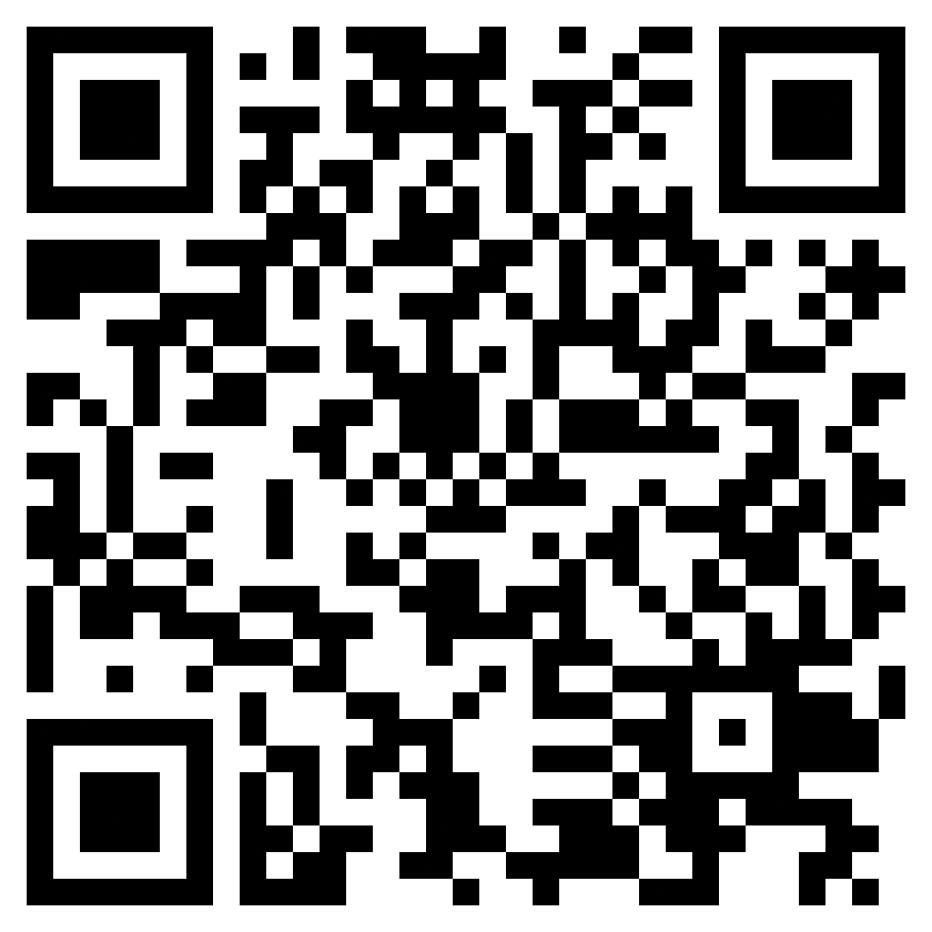
Q& A & Evaluation
https://bit.ly/3KU4YLQ

